Slide 1
Dark Web Essentials
Karien Barsoum
March 30, 2023

Slide 2

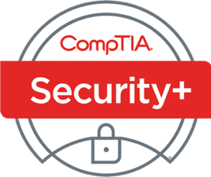

Getting Started with Dark Web Concepts (10 ways)
Join a local learning community
Use OSINT websites/resources
Get a certification (Ex: Security+, Certified Dark Web Analyst)
Buy formal hands-on training
Take dark web courses online
Shadow professionals with experience
Invest in a home lab environment
Read academic literature
Buy a book about the dark web
Join conferences to learn more

Slide 3



Recommended Gateways:
Tor
Easy to use and freely available.
Open-source, meaning that the code is open to public review and audit.
Access to the Tor network, which hosts a range of websites and services that are not available on the clearnet.
I2P
Offers stronger anonymity than Tor, as it provides end-to-end encryption for all communications.
Supports multiple protocols beyond web browsing, including email, IRC, and file sharing.
Open-source and actively developed.
Freenet
No central point of control or vulnerability to attack.
Allows users to access uncensored content and communicate anonymously.
Offers strong anonymity and privacy protection.

Slide 4
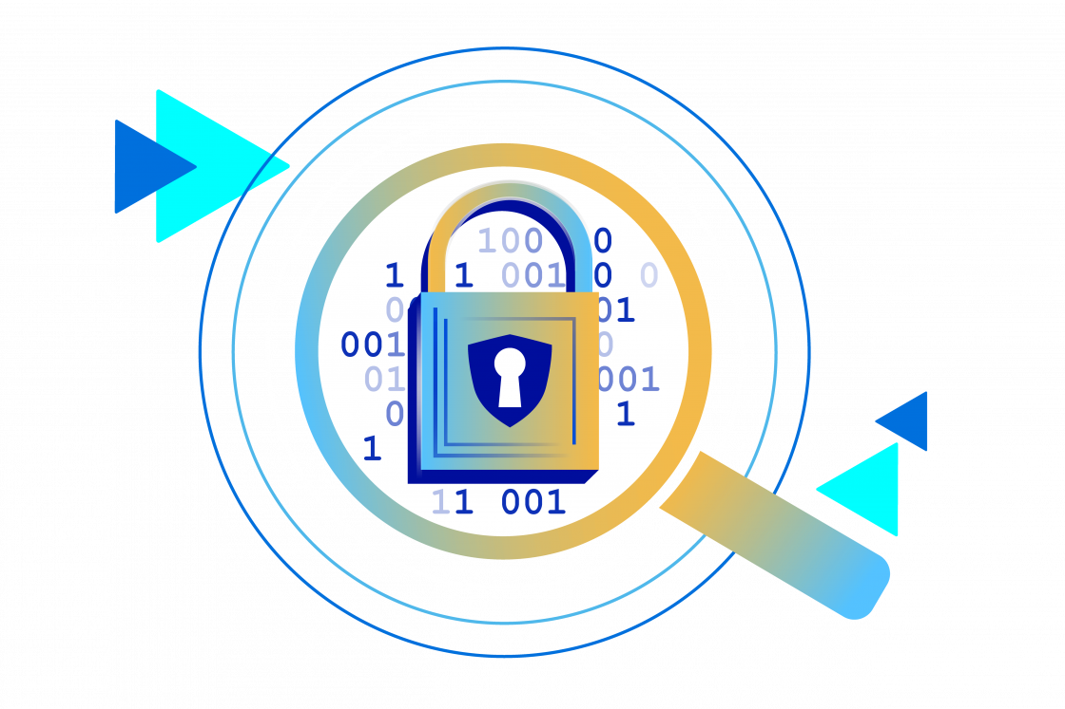
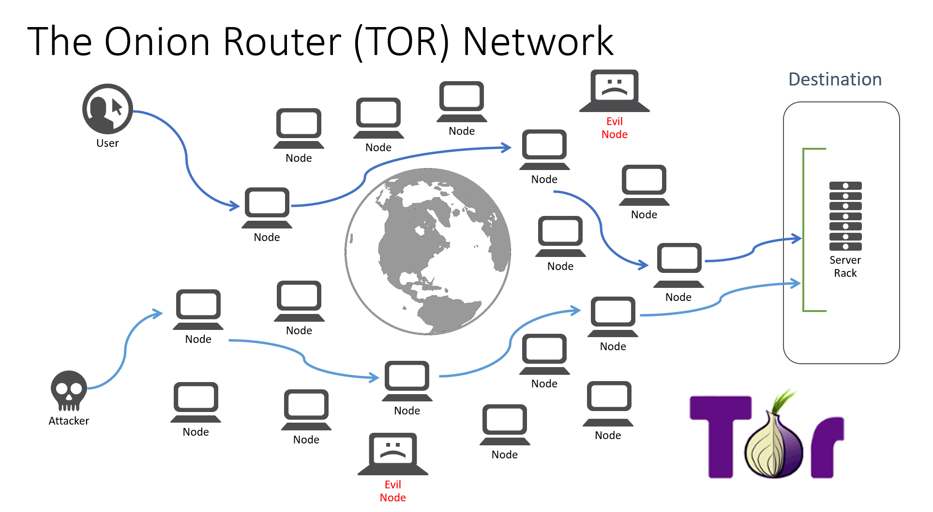
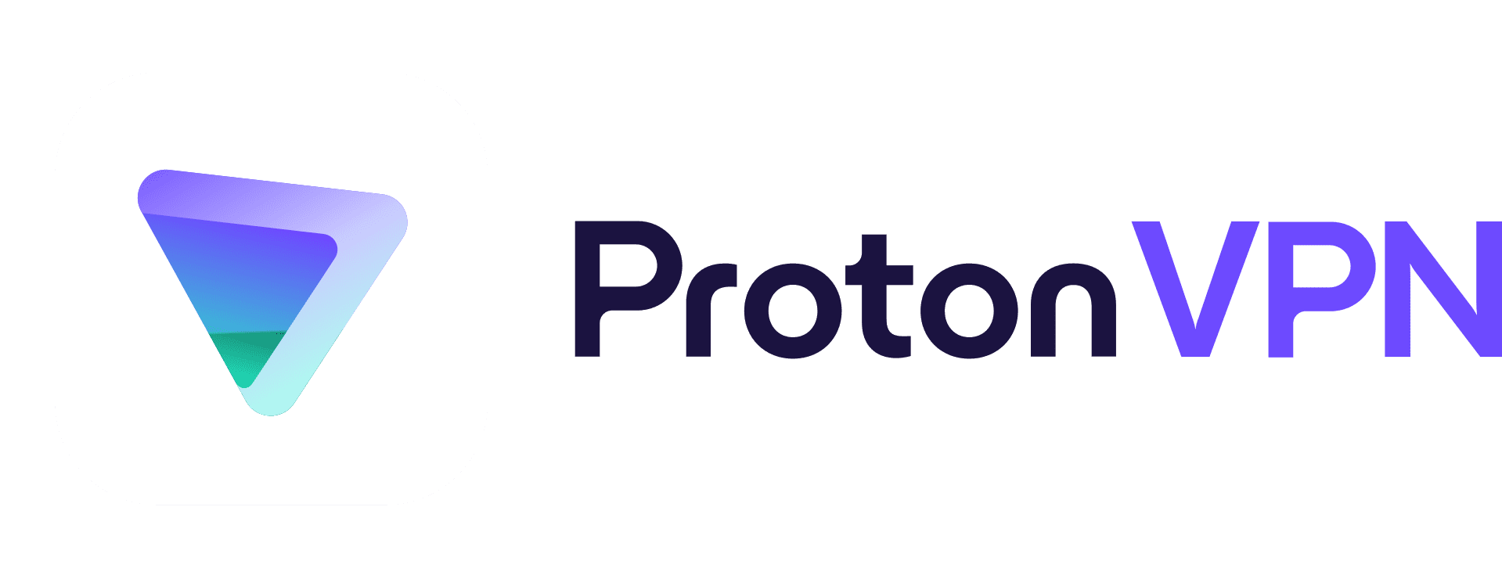
Privacy and Anonymity Within Dark Web
Tor network: Decentralized network of servers that facilitates onion routing and provides a high degree of privacy and anonymity.
Pseudonyms and encryption: Dark web users use pseudonyms and encryption to further protect their privacy and anonymity.
Cryptocurrency: Users avoid the need to provide personal information or bank account details, further protecting their privacy and anonymity.
VPNS: Protects users’ identity on the network with tunneling protocols, and increases your security but also ensures your privacy.

Slide 5



3 Ways Criminals Use the Dark Web
1 - To sell Illegal drugs as well as guides on how to make homemade illegal drugs
2 - Gather stolen identity information and health records on individuals across the world for hacking
3 - Provide hacker-for-hire services, or ransomware services

Slide 6
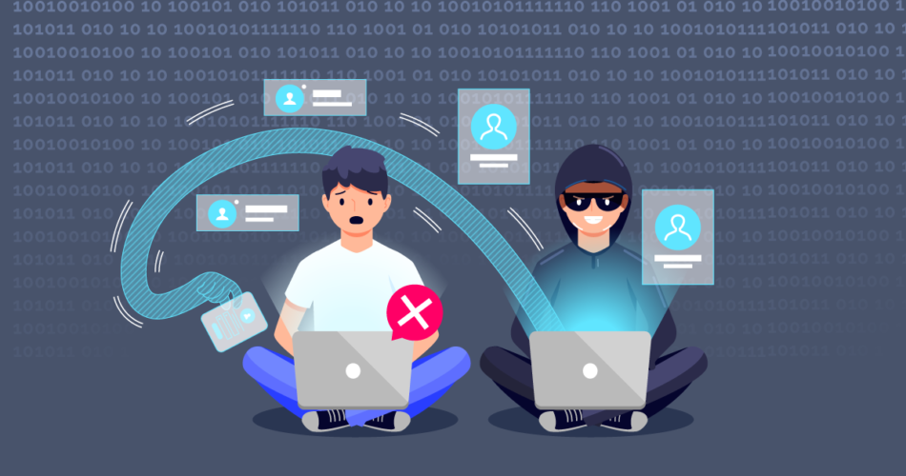
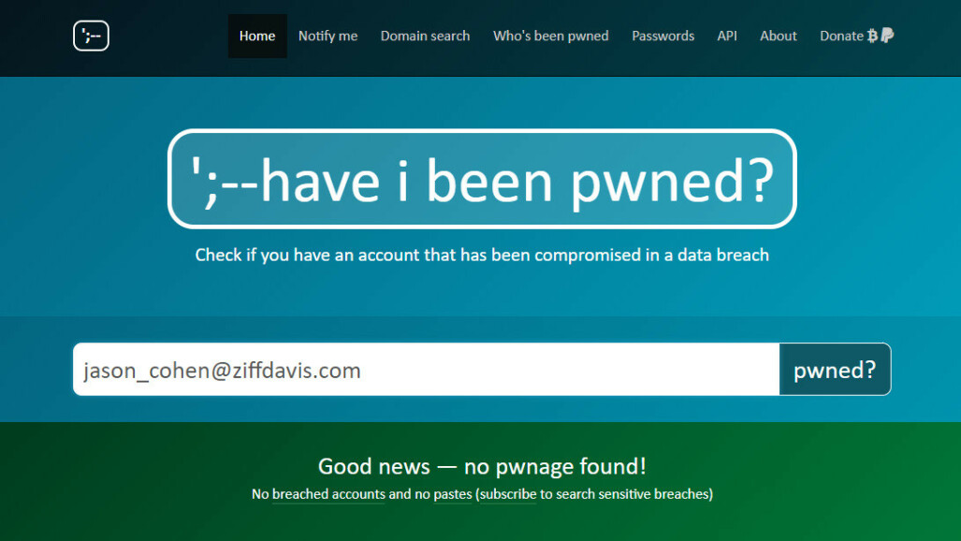
Recommendations on Validating Stolen Data
Keep an eye on your credit- Keep an eye on your credit reports for any unexpected behavior, and get a free credit report from each of the three main credit agencies once a year.
Examine dark web marketplaces- Check these marketplaces to determine whether your information is being sold.
Speak with a cybersecurity expert to determine the source of the incident and to take steps to protect data and avoid further harm.
Use haveibeenpwned to find out if your data was in a data breach

Slide 7
References
https://www.aura.com/learn/dark-web
https://darkwebcouncil.com/page/certified-dark-web-analyst
https://www.digitaltrends.com/computing/a-beginners-guide-to-tor-how-to-navigate-through-the-underground-internet/
https://www.privacyaffairs.com/install-tails/
https://www.ma-no.org/en/security/how-to-get-into-the-deep-web-a-guide-to-access-tor-zeronet-freenet-and-i2p
https://crsreports.congress.gov/product/pdf/IF/IF12172
https://ermprotect.com/blog/dark-web-cybercrime-central
https://www.ftc.gov/business-guidance/resources/data-breach-response-guide-business
https://www.comparitech.com/blog/vpn-privacy/access-dark-web-safely-vpn/

